Slide 1
Book Recommendation System
Team 6
1. Ankam Sujeeth
2. GUDEPU RAMBABU
3. Mrs. Smita Amol Kolhar
4. Mr. Sandip Chikane
5. Mrs. Monika Akshay Dhome
6. Miss . Gunde Manasa Goud
7. Miss. Bhagyashree Tondkal
Date :31-Jully-2023 Project Guide : Mr.Adhvaith Sir

Slide 2
OBJECTIVES :-
Book recommendation system helps an organization to create a loyal customer and build trust by them desired products & services for which they come on our site.
This system handle the new customer, who has visited site for first time and recommend product which are currently trending or highly rated and they can also recommend product which bring maximum profit to company.

Slide 3
Business Problems
Book Recommendation systems :
The book recommendation systems has strong impact on worlds economy.
book recommendation system has faces challenges to recommend books to new users.
Also some users not give any ratings so its little challenges to finding more rating books
and average of ratings.
lack of data is also challenging to recommend books to users.
If many user buy same product but do not leave any ratings ,it become difficult for recommendation system to recommend that particular product.
Changing trend of product suddenly, its difficult to recommend quick changes in trend.

Slide 4
Project Architecture
1.Define problem
2.Collecting and Reading data set
3.EDA{Exploratory data Analysis}
4.Data cleaning/Data Preprocessing.
5.Build a model.
6.Deployment the system using streamlit.

Slide 5
Exploratory Data Analysis
1.Analyze the data
2.Cleaning data
3.Merged Data Set
4.Visualization
5.Imputation technique
6.Building different model

Slide 6
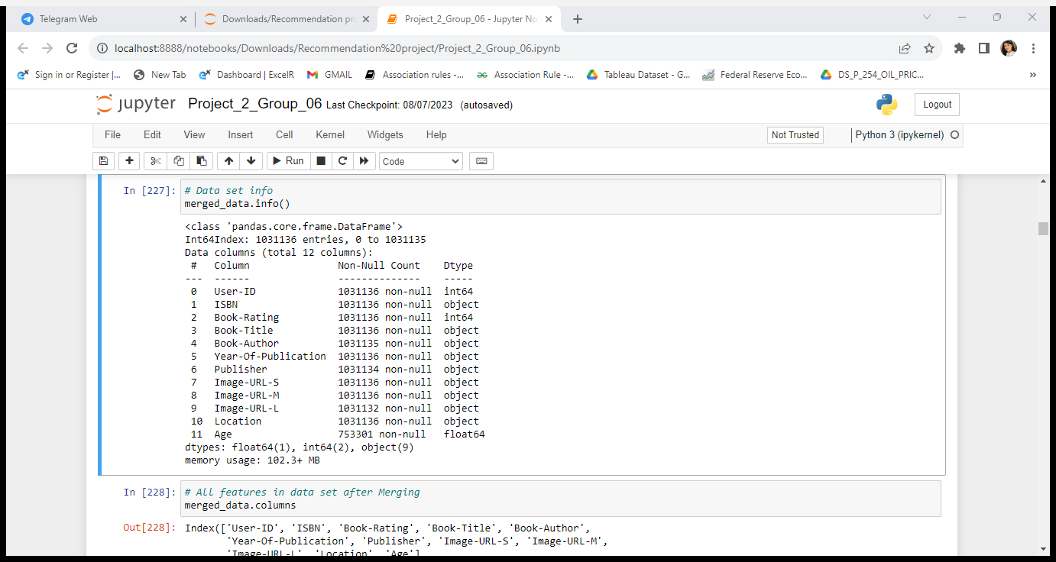
Data Set Details:
1.This data set consist of 1031136 entries.
2.And 3 required features.

Slide 7
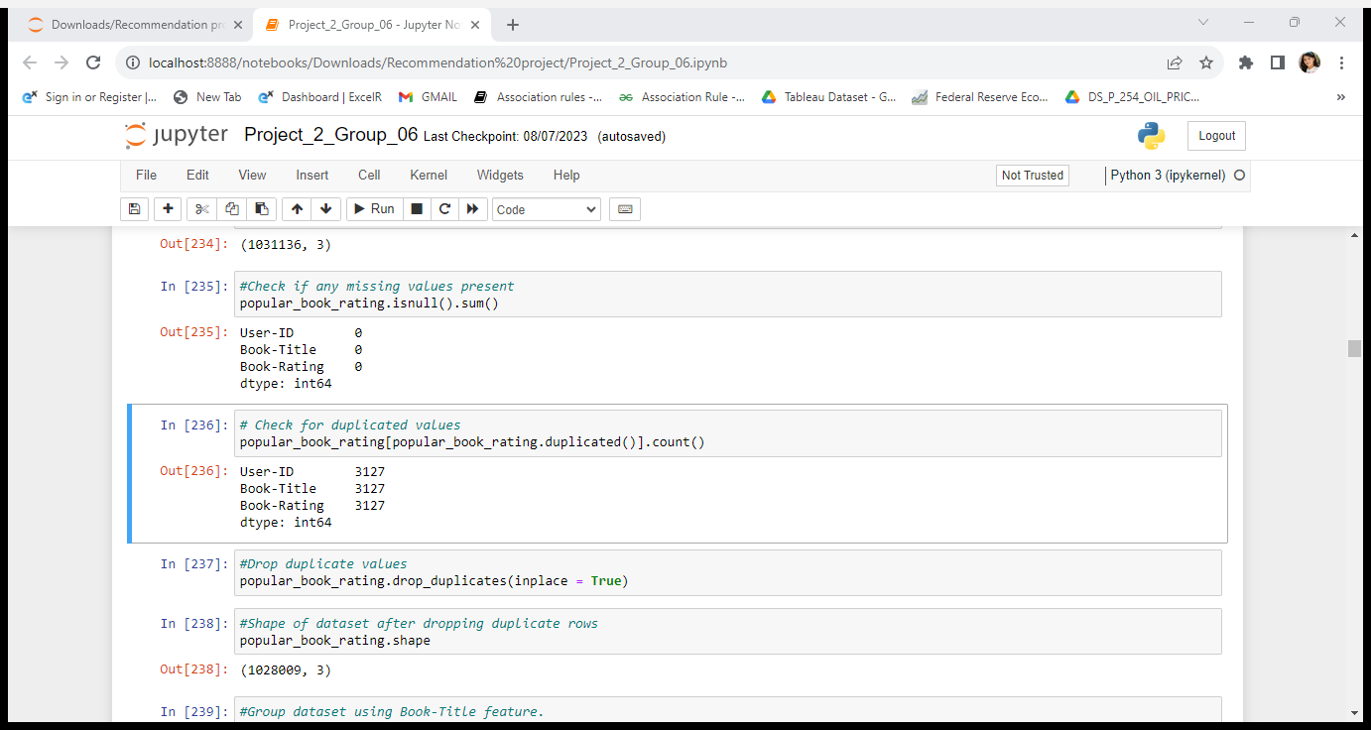
Cleaning Data:
1.Missing value Imputation:
2.The required feature contain Zero null value.so we continue with that dataset.

Slide 8
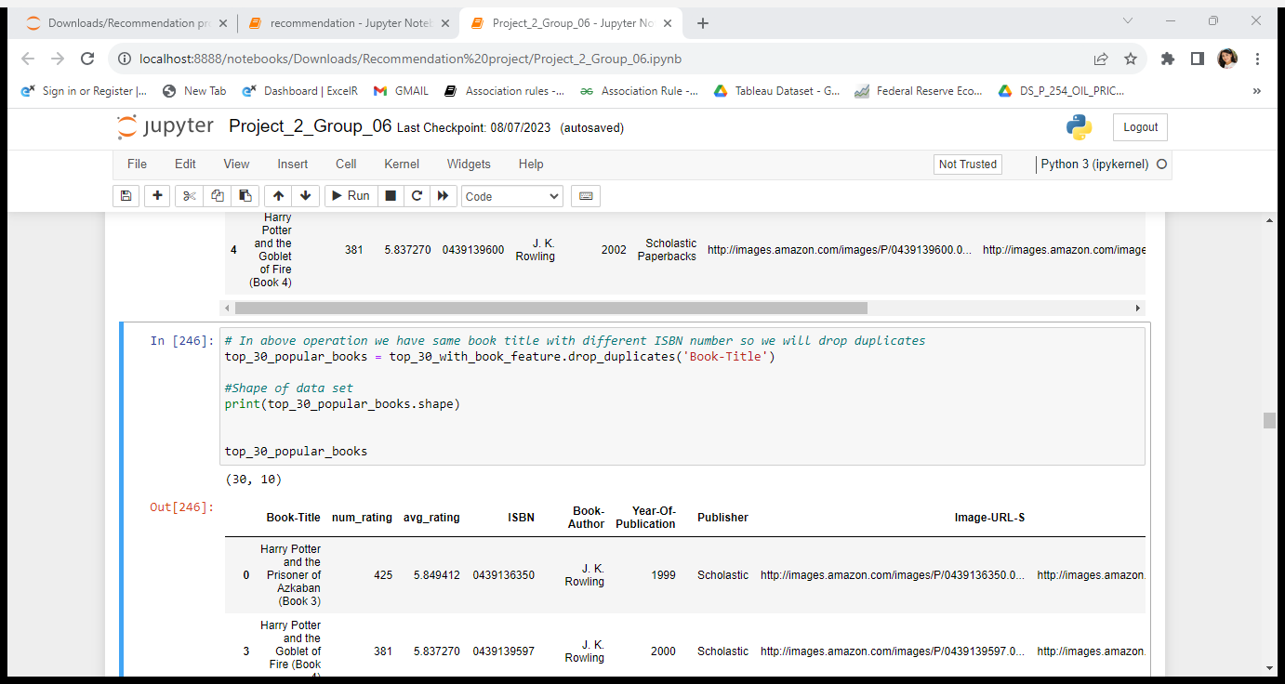
EDA[Exploratory Data Analysis]
1.Drop duplicated value from dataset.
2.Group dataset using book title feature.
3.After that finding top 30 popular books data.

Slide 9
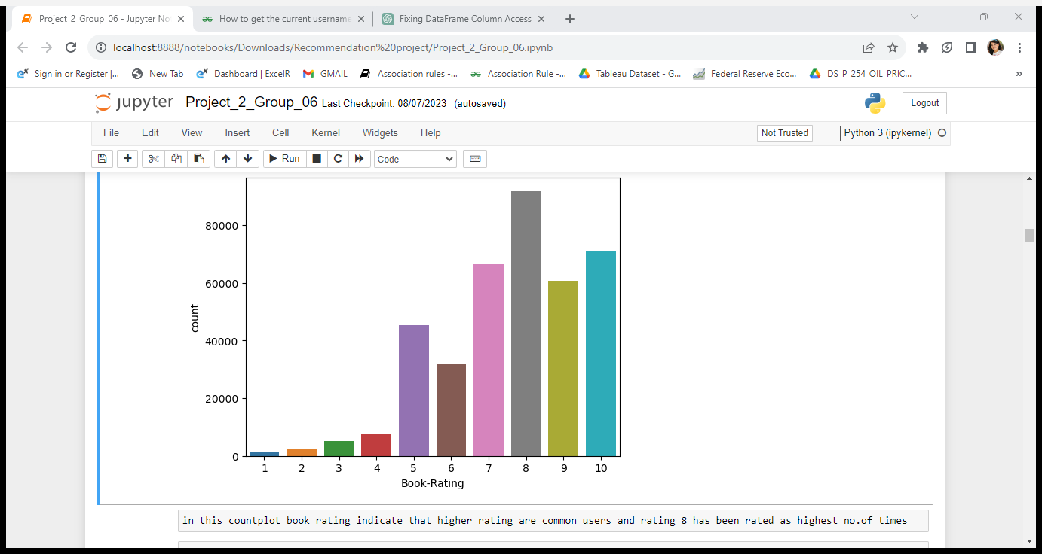
Visualization:
1.Higher rating of common user and rating 8 has been rated as highest number of times

Slide 10
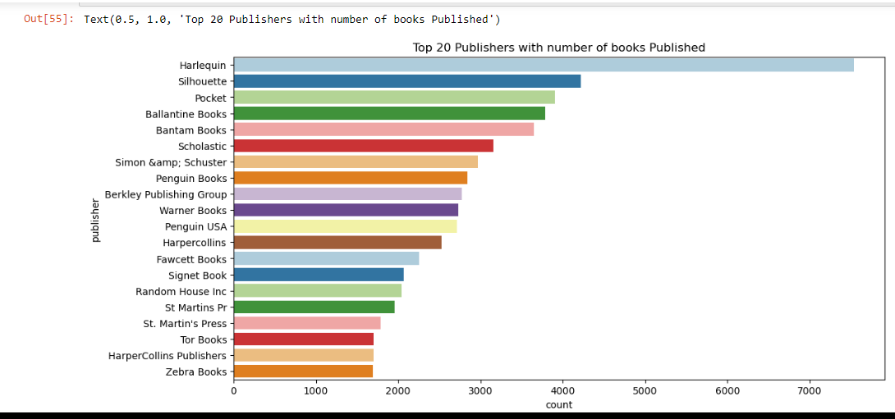
Top Publisher with Published book

Slide 11
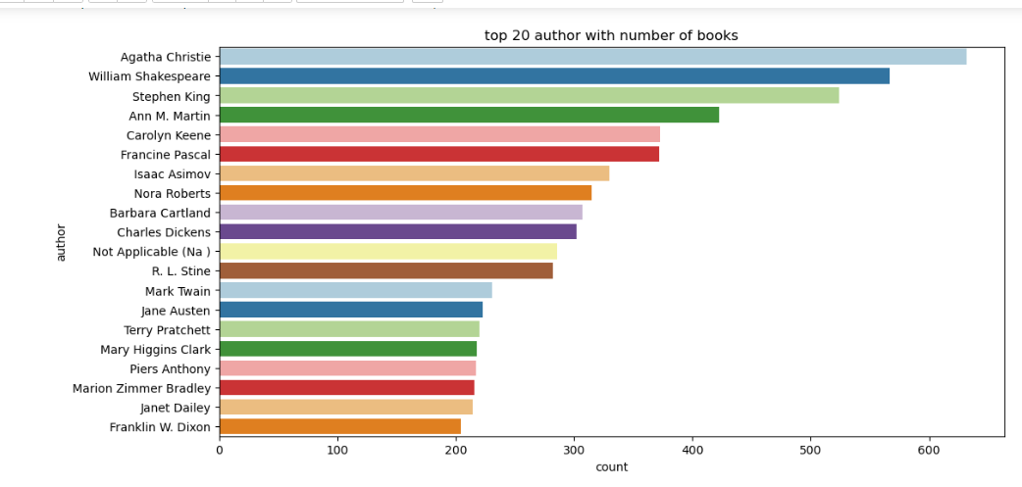
Top Author with number of books.

Slide 12
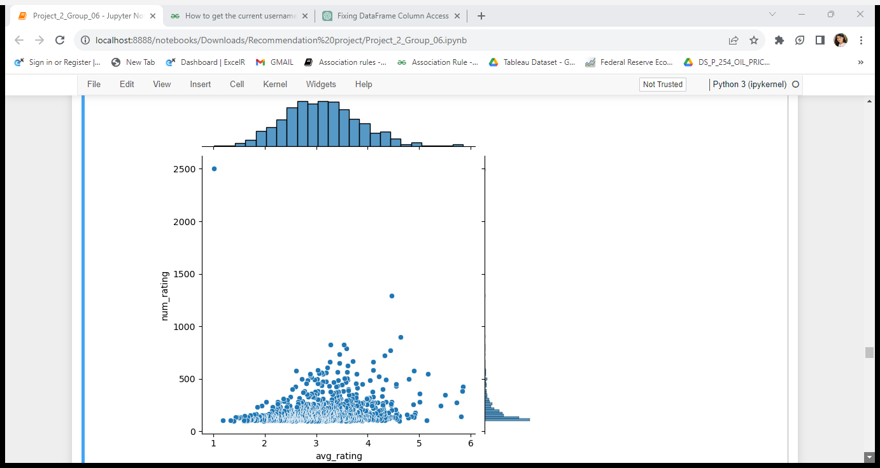
Also use the joint plot to check correlation between average rating & number of ratings.

Slide 13
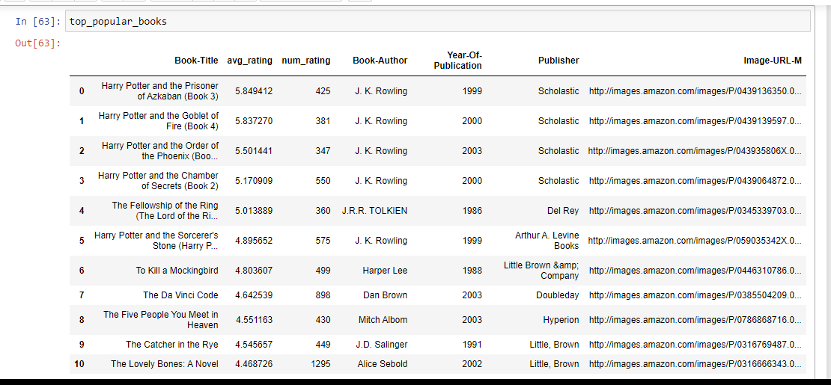
Recommendation based on popularity.
Top Popular Books

Slide 14
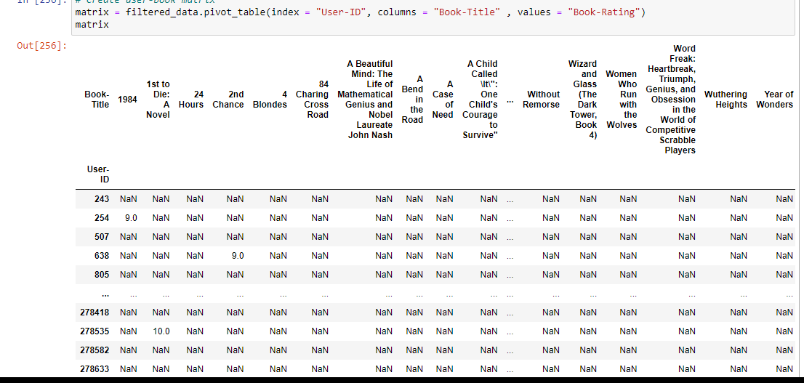
Collaborative Filtering based Recommendation systems :
For Collaborative Based Recommendation system, we will filter the books and keep only those with over 100 ratings for the analysis and users rated books more than 10.
For this, we group the books by title, count the number of ratings, and keep only the books with greater than 100 ratings and users rated books more than 10 books.

Slide 15
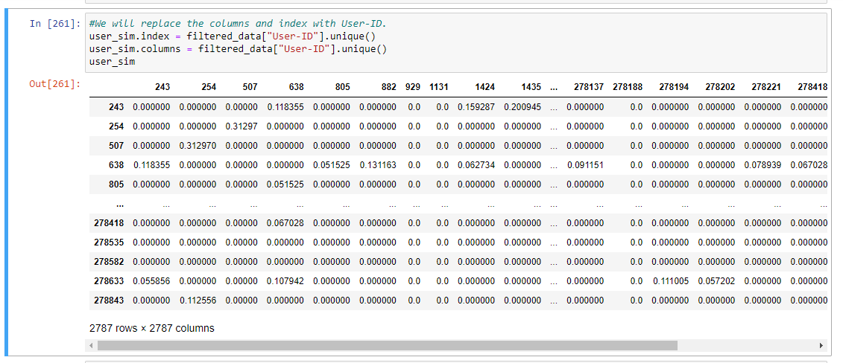
We will replace column and index with user_id

Slide 16
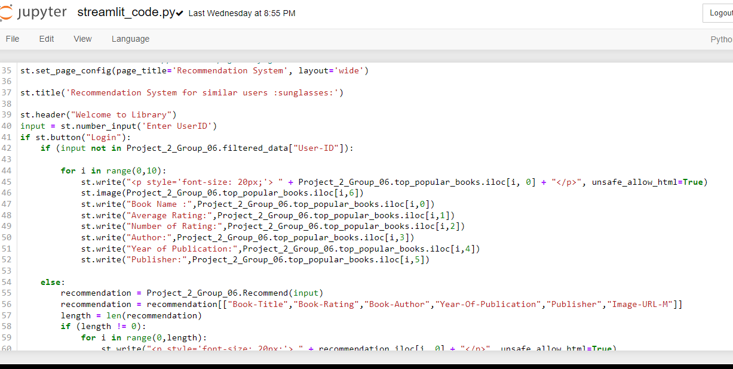
Deployment of book recommendation system using streamlit

Slide 17
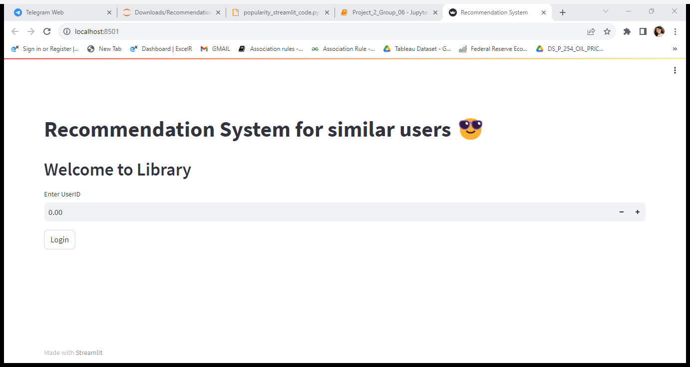
Output displays when running the code:

Slide 18
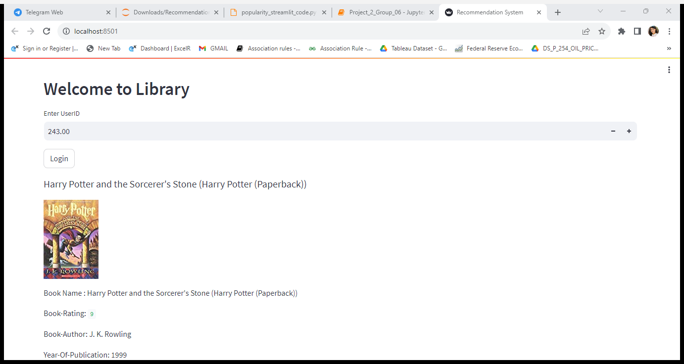
when entering user-id the output shown as below:

Slide 19
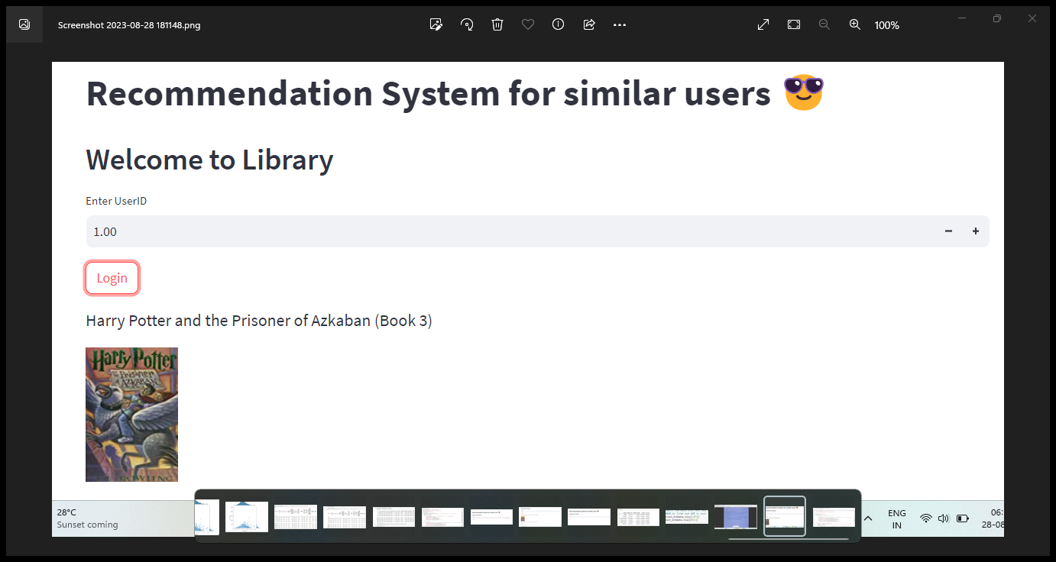
When user id is different than other i.e., new user then our system shows top popular books.

Slide 20
Challenge faced:
1.The dataset has three different files, each has different feature.so dataset is large its complicated to merge it and removing duplicated and null values.
2.We had faced some challenges to get good data by using EDA analysis technique.
3.We build popularity based and collaborative filtering based model to get best recommendation of book to users.
4.After choosing model we build deployment file by using streamlit its little complex to build it.

Slide 21
Overcome the challenges:-
1.To getting good data we try different EDA techniques and different analysis on given data
2.Also perform some visualization for better understanding.
3.Firstly choose most popular books from given data using popularity based recommendation system.
4. After build collaborative filtering based model by installing some libraries, packages.
5.Challenges faced more but its overcome by searching some documentation ,research paper, project guide to solve this all errors.
6.At deployment of book recommendation system its more complex to build it but by using different sources we overcome it .

Slide 22
Thank you

